Slide 1
Transmission Interval of Trigger Frame
Date: 2015-07-12
Authors:

Slide 2
Abstract
Tgax has adopted the trigger frame to solicit the transmission of UL MU PPDUs from multiple STAs [1].
To maximize the benefit of UL MU, the AP needs to adjust how often it sends trigger frames depending on the number of STAs and their traffic.
In this contribution, we examine ways to maximize the UL benefit by controlling the trigger frame transmission interval.

Slide 3
Problem
Since STAs don’t know when the trigger will be sent, it can choose to just send by random access UL SU.
AP
Trigger
STA 1
SU-DATA
SU-DATA
STA 2
SU-DATA
UL
MU
STA 3
SU-DATA
STA 4
Solution: Define a mechanism to enable STAs to reassign SU transmissions to the next UL-MU session

Slide 4
Possible Strategies
Inform STAs of next Trigger transmit time
In addition, the STA can send Trigger transmit schedule if available.
This way, STAs can voluntarily align it’s transmission timing.
Allow AP to restrict some transmissions to UL MU
Has the additional benefit of making the STA transmit distribution more predictable in contention period.

Slide 5
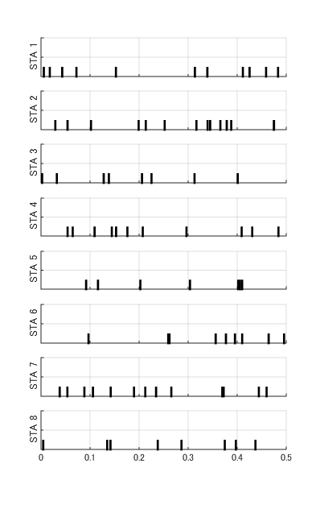
Example
No. of STAs = 8
PHY Rate=54Mbps
Application Layer Traffic Model = Exponential distribution with 500kbps bit rate.
What is the effect of the STA random access SU UL transmissions on the overall BSS throughput?
Note: Each mark represents roughly 3KB of data

Slide 6
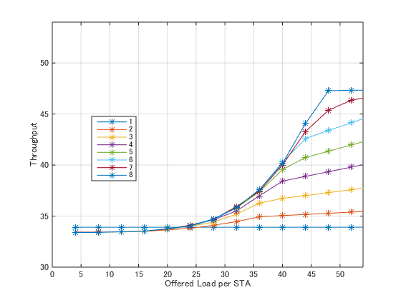
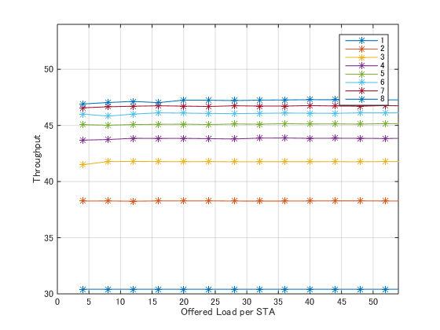
Analysis Results
UL MU benefit is non-existent at offered loads below saturation
High efficiency at all offered loads
No. of ParallelSTAs
No. of Parallel STAs
Without SU transmission reassignment
With SU transmission reassignment
Trigger Frame strategy :
=> AP triggers based on average throughput information of all STAs

Slide 7
Conclusion
By maximizing the use of UL MU, either by voluntary STA control of random access UL SU transmissions or forced AP restriction, high efficiencies can be achieved even at non-saturated offered loads.

Slide 8
References
[1] 802.11-15/0132r05 “TGax Specification Framework”

Slide 9
Strawpoll
Do you agree that trigger frames shall contain information about its transmission schedule.
Y/N/A:

